Slide 1
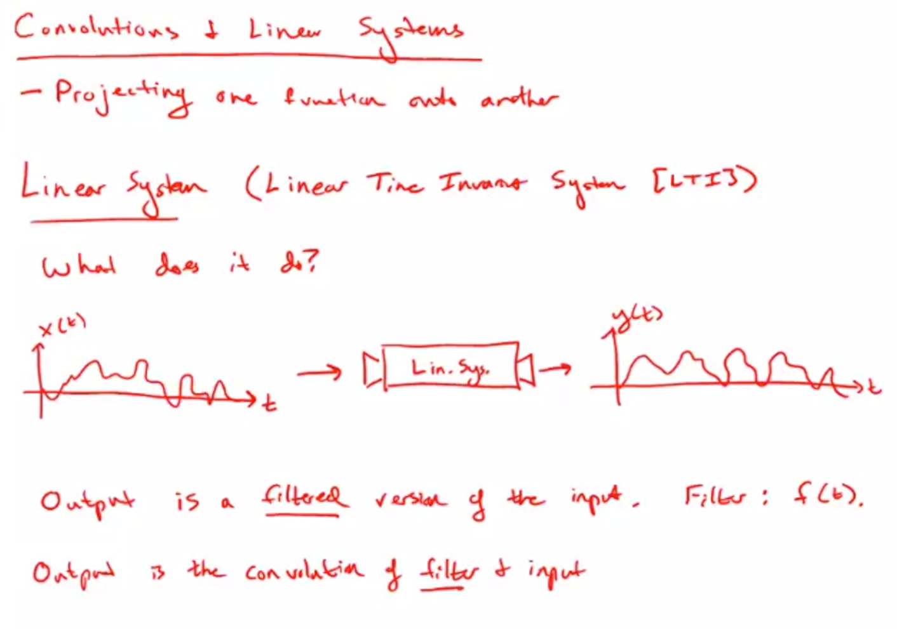
Notes:
To get the output, you convolve the filter with the input.

Slide 2
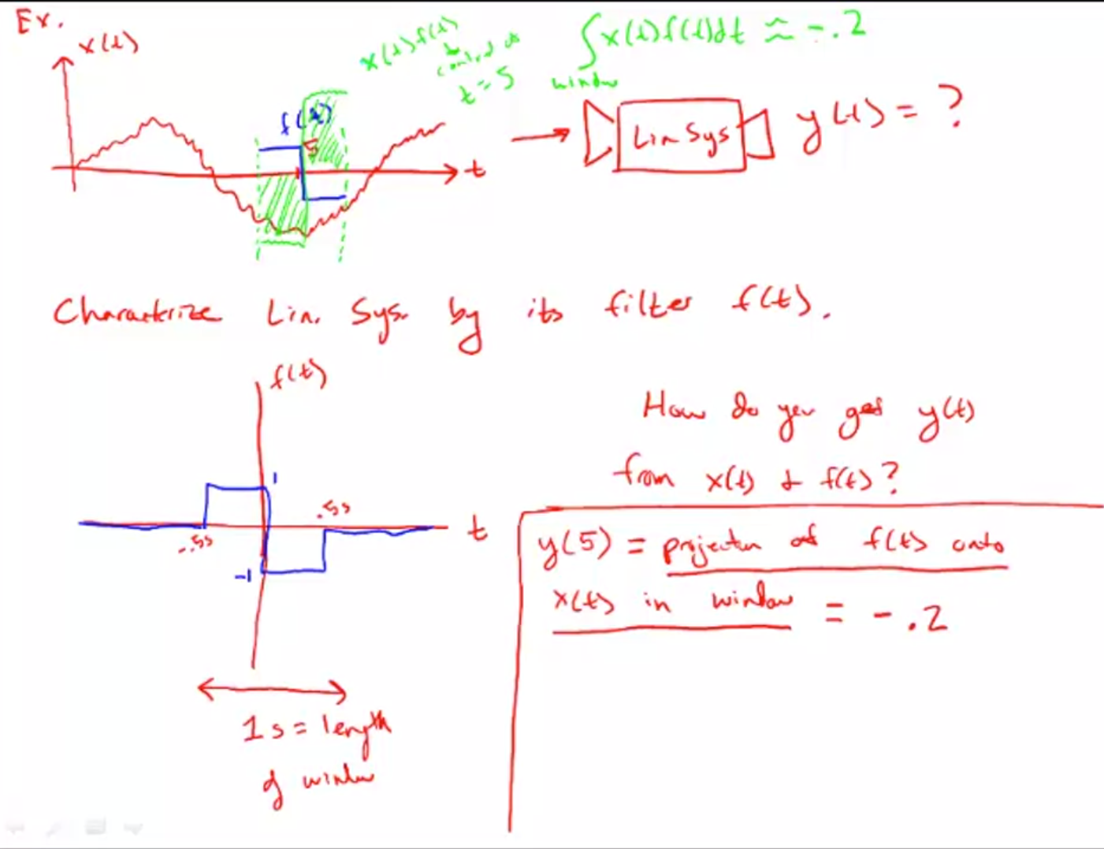

Slide 3
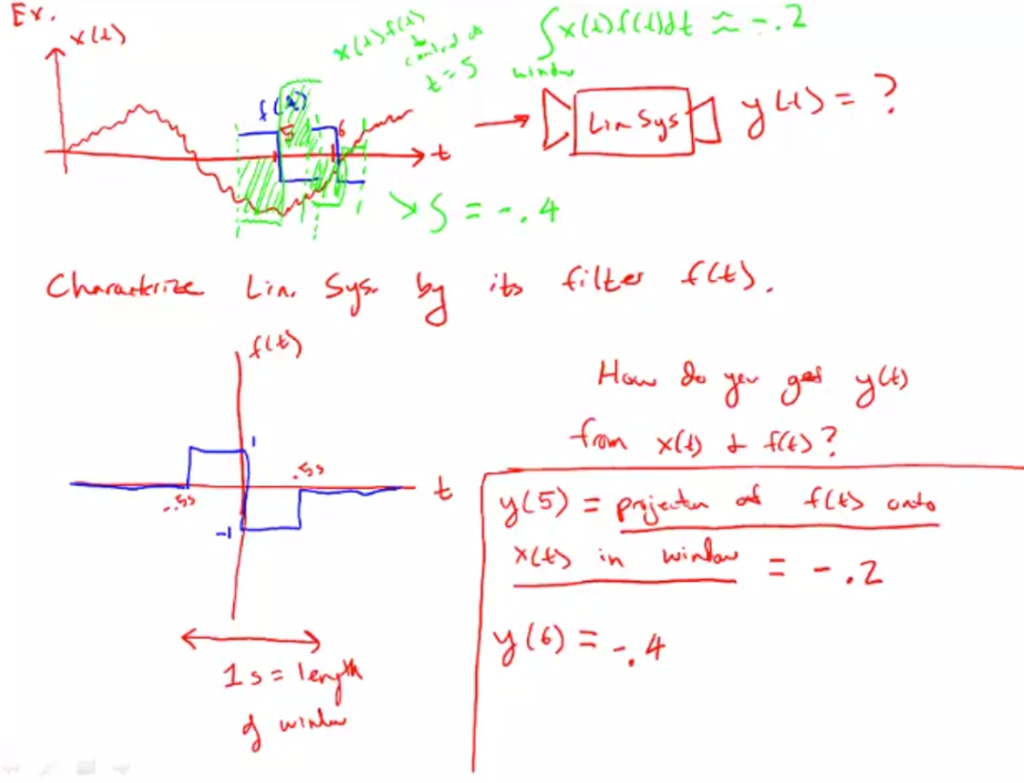

Slide 4
